Slide 1


Slide 2
Implied Volatility
The implied volatility of an option is the volatility for which the Black-Scholes-Merton price equals the market price
There is a one-to-one correspondence between prices and implied volatilities
Traders and brokers often quote implied volatilities rather than dollar prices

Slide 3
Chapter 19 The Greek Letters

Slide 4
Example
A bank has sold for $300,000 a European call option on 100,000 shares of a non-dividend paying stock
S₀ = 49, K = 50, r = 5%, σ = 20%,
T = 20 weeks, μ = 13%
The Black-Scholes-Merton value of the option is $240,000
How does the bank hedge its risk to lock in a $60,000 profit?

Slide 5
Naked & Covered Positions
Naked position
Take no action
Covered position
Buy 100,000 shares today
What are the risks associated with these strategies?

Slide 6
Greek Letters
Greek letters are the partial derivatives with respect to the model parameters that are liable to change
Usually traders use the Black-Scholes-Merton model when calculating partial derivatives
The volatility parameter in BSM is set equal to the implied volatility when Greek letters are calculated. This is referred to as using the “practitioner Black-Scholes” model

Slide 7
Delta (See Figure 19.2)
Delta (Δ) is the rate of change of the option price with respect to the underlying asset price
Call option price
Slope = Δ = 0.6
B
A
Stock price

Slide 8
Hedge
Trader would be hedged with the position:
short 1000 options
buy 600 shares
Gain/loss on the option position is offset by loss/gain on stock position
Delta changes as stock price changes and time passes
Hedge position must therefore be rebalanced

Slide 9
Delta Hedging
This involves maintaining a delta neutral portfolio
The delta of a European call on a non-dividend paying stock is N (d ₁)
The delta of a European put on the stock is
N (d ₁) – 1

Slide 10
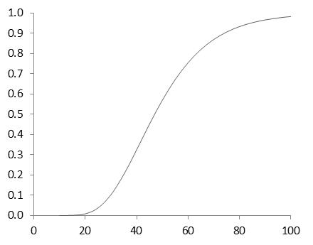
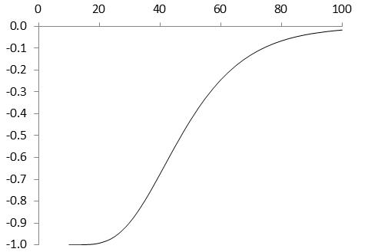
Delta of a Stock Option (K=50, r=0, σ = 25%, T=2, Figure 19.3)
Call
Put

Slide 11
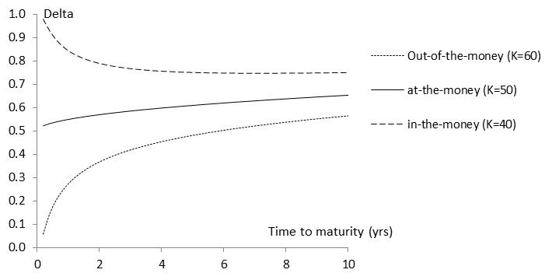
Variation of Delta with Time to Maturity(S₀=50, r=0, σ=25%, Figure 19.4)

Slide 12
The Costs in Delta Hedging continued
Delta hedging a written option involves a “buy high, sell low” trading rule

Slide 13
Second Scenario for the Example (Table 19.3)
Week | Stock price | Delta | Shares purchased | Cost (‘$000) | Cumulative Cost ($000) | Interest
0 | 49.00 | 0.522 | 52,200 | 2,557.8 | 2,557.8 | 2.5
1 | 49.75 | 0.568 | 4,600 | 228.9 | 2,789.2 | 2.7
2 | 52.00 | 0.705 | 13,700 | 712.4 | 3,504.3 | 3.4
....... | ....... | ....... | ....... | ....... | ....... | .......
19 | 46.63 | 0.007 | (17,600) | (820.7) | 290.0 | 0.3
20 | 48.12 | 0.000 | (700) | (33.7) | 256.6

Slide 14
Theta
Theta (Θ) of a derivative (or portfolio of derivatives) is the rate of change of the value with respect to the passage of time
The theta of a call or put is usually negative. This means that, if time passes with the price of the underlying asset and its volatility remaining the same, the value of a long call or put option declines

Slide 15
Gamma
Gamma (Γ) is the rate of change of delta (Δ) with respect to the price of the underlying asset
Gamma is greatest for options that are close to the money

Slide 16
Gamma Addresses Delta Hedging Errors Caused By Curvature (Figure 19.7)
Call
price
C''
C'
C
Stock price
S
S'

Slide 17
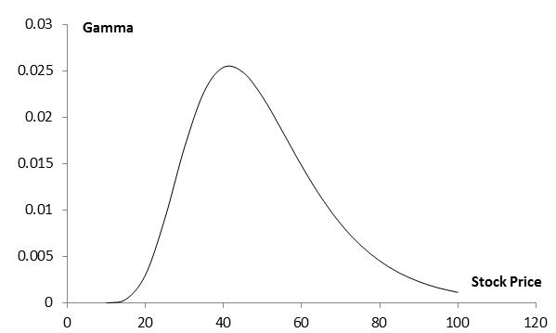
Gamma for Call or Put Option: (K=50, σ = 25%, r = 0%, T = 2, Figure 19.9)

Slide 18
Vega
Vega (ν) is the rate of change of the value of a derivatives portfolio with respect to volatility
If vega is calculated for a portfolio as a weighted average of the vegas for the individual transactions comprising the portfolio, the result shows the effect of all implied volatilities changing by the same small amount

Slide 19
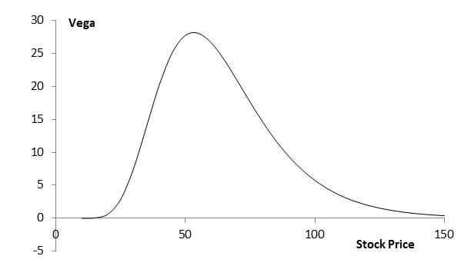
Vega for Call or Put Option (K=50, σ = 25%, r = 0, T = 2, Figure 19.11))

Slide 20
Taylor Series Expansion (Appendix to Chapter 19)
The value of a portfolio of derivatives dependent on an asset is a function of of the asset price S, its volatility σ, and time t

Slide 21
Managing Delta, Gamma, & Vega
Delta can be changed by taking a position in the underlying asset
To adjust gamma and vega it is necessary to take a position in an option or other derivative

Slide 22
Rho
Rho is the rate of change of the value of a derivative with respect to the interest rate

Slide 23
Hedging in Practice
Traders usually ensure that their portfolios are delta-neutral at least once a day
Whenever the opportunity arises, they improve gamma and vega
There are economies of scale
As portfolio becomes larger hedging becomes less expensive per option in the portfolio

Slide 24
Greek Letters for European Options on an Asset that Provides a Yield at Rate q (Table 19.6)
Greek Letter | Call Option | Put Option
Delta
Gamma
Theta
Vega
Rho
In practice, the volatility, σ, is usually set equal to the implied volatility

